Slide 1

Hospital
Data Analysis

Slide 2
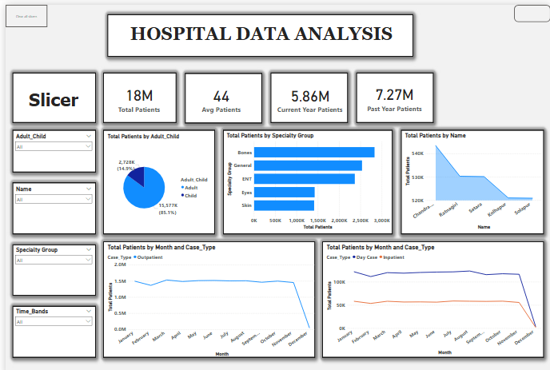

Slide 3
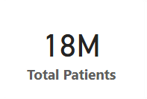
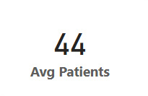
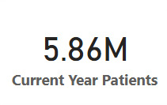
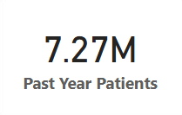
Measures :-
Total Number of Patients Admitted in the Hospital
Average Number of Patients Admitted per Day
Number of Patients Admitted This Year
Number of Patients Admitted Last Year

Slide 4
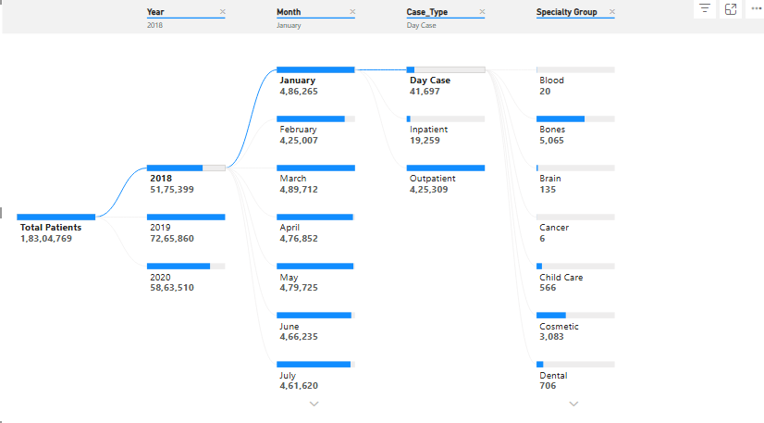
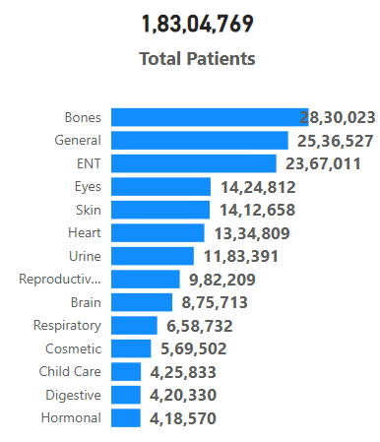
Decomposition Tree
Tooltip

Slide 5
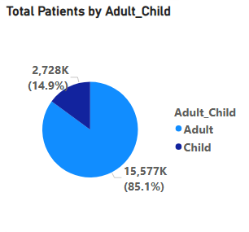
Pie Chart
Total Patients by Adult and Child Age Group
This chart shows that :-
The comparison of the numbers of patients admitted between adult and child.
The adult group contains 85% of total patients.
The child group contains 15% of total patients.

Slide 6
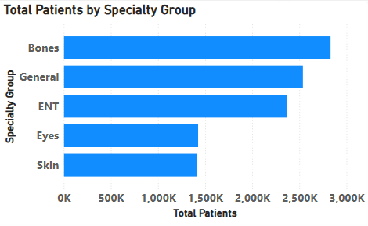
Bar Chart
Total Patients by the Specialty Groups
This chart shows that :-
Top 5 departments which has highest number of patients.
The most of the patients visited hospital for the problems regarding to Bones, ENT and General

Slide 7
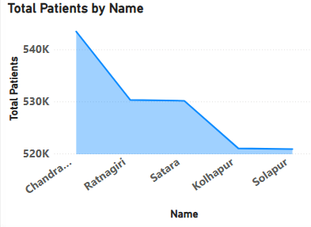
Area Chart
Total number of patients District Name
This chart shows that :-
Top 5 districts which had most numbers of patients.
The Chandrapur had the highest number of patients.

Slide 8
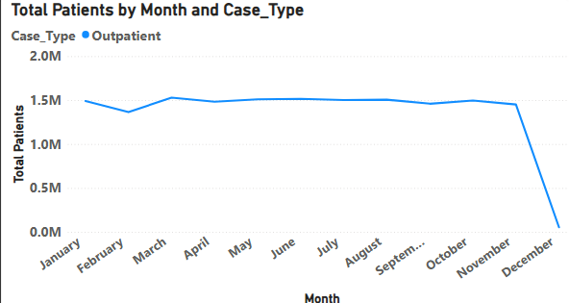
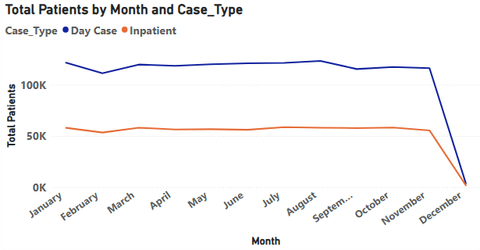
Line Chart
This chart shows that :-
There is small fall in number of patients admitted in November and December
Outpatients are higher than Inpatients and Day patient.
This chart shows that :-
The day patients are more as compare to Inpatients.

Slide 9
Suggestions for Hospital :-
Hospital should ensure that enough doctors, beds, and service focused on the adult patients since they form the majority.
Provide more doctors, staffs, and services to the department like Bone and General which has the most number of patients to reduce the waiting time and improve the treatment of the patients.
Review paediatric department needs – like equipment, play area, or child-friendly spaces – to improve experience and care.

